Slide 1

Unit I - Trees
BRACT’S, Vishwakarma Institute of Information Technology, Pune-48
(An Autonomous Institute affiliated to Savitribai Phule Pune University)
(NBA and NAAC accredited, ISO 9001:2015 certified)
Advanced Data Structures
Ms. Devika Verma
Computer Eng. Dept., VIIT, Pune

Slide 2
Objectives of this session
1. Understand difference between linear and non linear data structure
2. Understand concept of Trees
3. Introduce basic properties of trees
1. Differentiate between linear and non linear data structure
2. Understand basic terminologies of trees
3. Understand basic properties of trees
Learning Outcome/Course Outcome

Slide 3
Contents
Part –I
Difference between linear and non-liner data structure
Trees and Binary trees- basic terminology
Representation using linked organization
Binary tree- properties
Converting general tree to binary tree
Part-II
Binary tree traversals recursive and non-recursive: depth first and breadth first.
Binary Search Tree (BST)
BST operations: Create, Display , Insertion and Deletion

Slide 4
Linear Vs. non linear data structures
Linear
Non-Linear
Arrays, linked lists, stacks and queues
Constructed by attaching data elements one after the other
Data elements are traversed one after the other in a single run
Data elements are organized sequentially and therefore they are easy to implement in the computer’s memory.
Trees and graphs
Constructed by attaching a data element to several other data elements in such a way that it reflects a specific relationship among them. Non sequential organization
All data elements cannot be traversed in single run
Due to nonlinear structure, they might be difficult to be implemented in computer’s linear memory

Slide 5
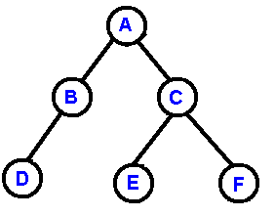
Trees
We extend the concept of linked data structures to structure containing nodes with more than one referenced field.
A binary tree is made of nodes, where each node contains a "left" reference, a "right" reference, and a data element.
The topmost node in the tree is called the root.

Slide 6
Trees Terminology
Every node (excluding a root) in a tree is connected by a directed edge from exactly one other node. This node is called a parent.
Binary tree is a tree in which no node can have more than two subtrees
On the other hand, each node can be connected to arbitrary number of nodes, called children.
Nodes with no children are called leaves, or external nodes.
Nodes which are not leaves are called internal nodes.
Nodes with the same parent are called siblings.

Slide 7
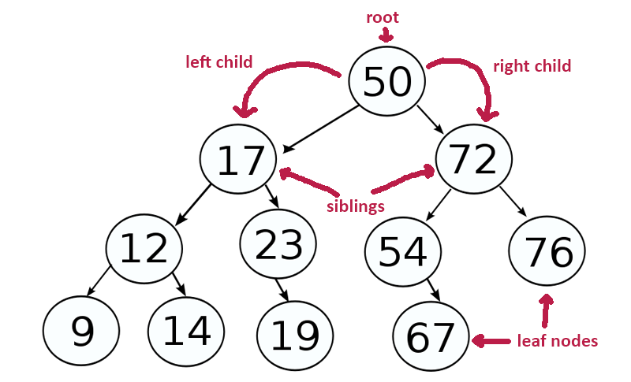
Tree

Slide 8
Collection of Binary Trees

Slide 9
Trees more Terminologies
The depth of a node is the number of edges from the root to the node.
The height of a node is the number of edges from the node to the deepest leaf.
The height of a tree is a height of the root i.e. the number of edges from the node to the deepest leaf.
The number of branches associated with a node is the degree of the node.
When a branch is directed towards the node, its an indegree branch and when the branch is directed away from node its an outdegree branch

Slide 10
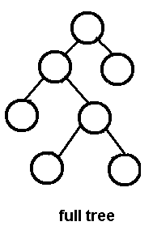
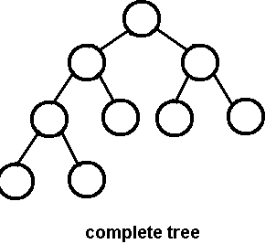
more Terminologies
A full binary tree is a binary tree in which each node has exactly zero or two children.
A complete binary tree is a binary tree, which is completely filled, with the possible exception of the bottom level, which is filled from left to right.

Slide 11
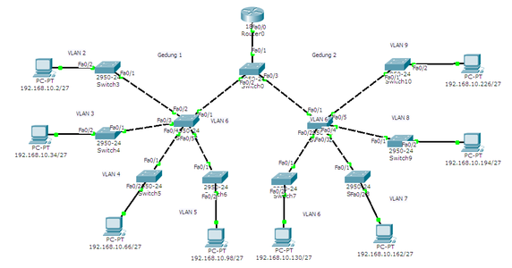
Applications of trees
Network Routing

Slide 12
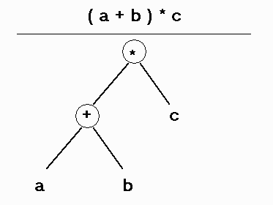
Applications of trees
Syntax Tree in Compiler : In compiler , every expression is converted into syntax tree format.

Slide 13
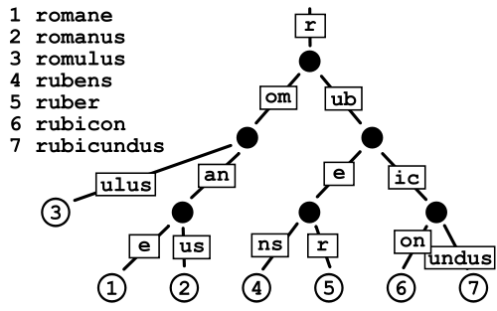
Applications of trees
Auto corrector and spell checker :

Slide 14
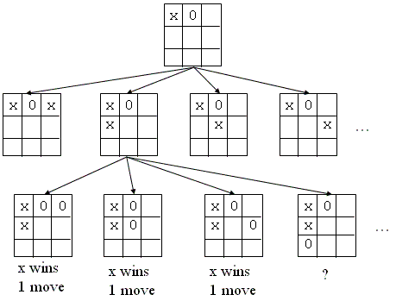
Applications of trees
Artificial Intelligence Games (opponent is cpu) , next moves are stored using tree data structure.

Slide 15
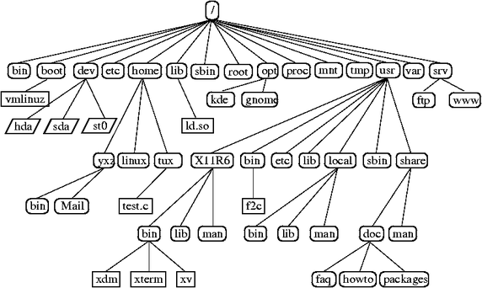
Applications of trees
Linux File System

Slide 16
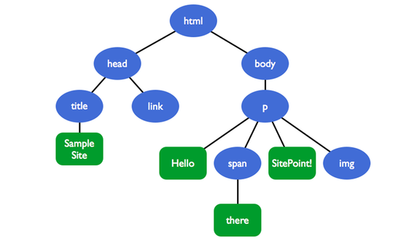
Applications of trees
HTML Document Model

Slide 17
Tree traversals
A traversal is a process that visits all the nodes in the tree.
Since a tree is a nonlinear data structure, there is no unique traversal.
We will consider several traversal algorithms with we group in the following two kinds
depth-first traversal
breadth-first traversal

Slide 18
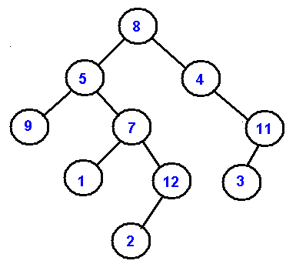
breadth-first traversal
There is only one kind of breadth-first traversal--the level order traversal.
This traversal visits nodes by levels from top to bottom and from left to right.
Level Order - 8, 5, 4, 9, 7, 11, 1, 12, 3, 2

Slide 19
DEPTH FIRST TRAVERSAL
There are three different types of depth-first traversals:
PreOrder traversal - visit the parent first and then left and right children
8, 5, 9, 7, 1, 12, 2, 4, 11, 3
InOrder traversal - visit the left child, then the parent and the right child
9, 5, 1, 7, 2, 12, 8, 4, 3, 11
PostOrder traversal - visit left child, then the right child and then the parent
8, 5, 9, 7, 1, 12, 2, 4, 11, 3

Slide 20
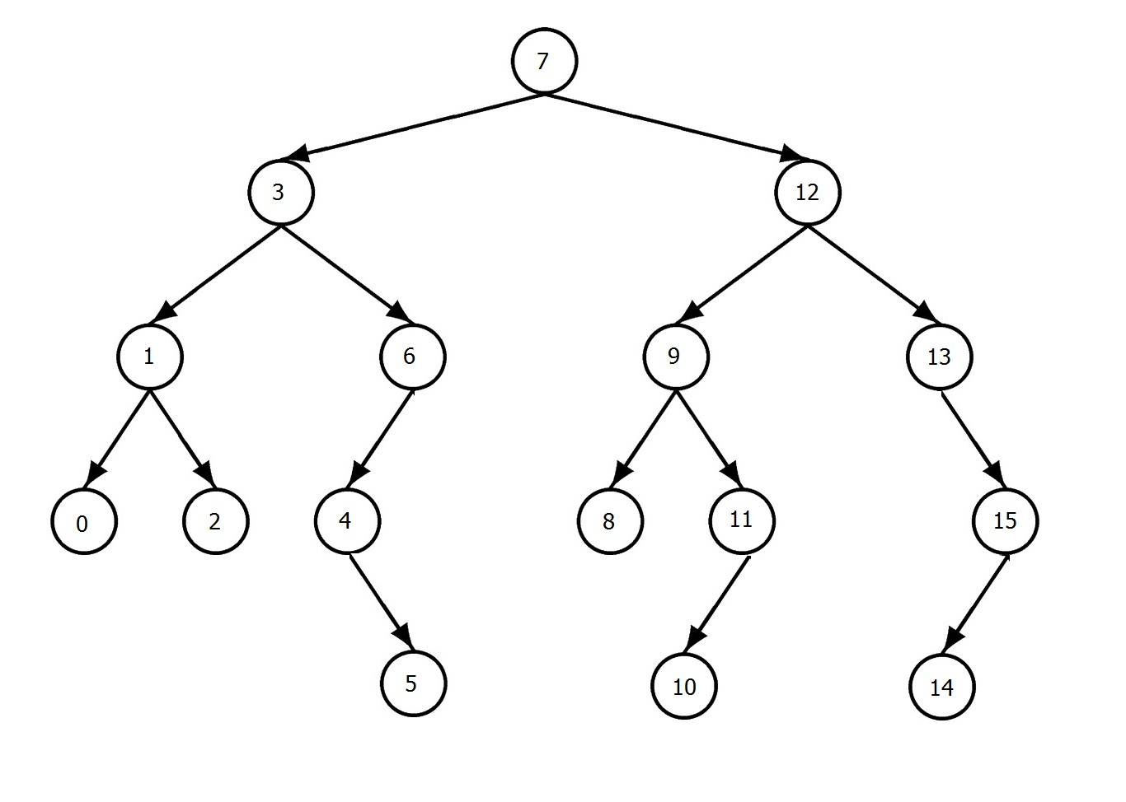
Exercise
Write inorder , preorder , post order traversals for following tree

Slide 21
GENERAL TREES
A general tree is a tree in which each node can have unlimited outdegree
Binary trees are easier to represent than general trees
We can represent any general tree in binary trees format using following two relationships:
Parent to child
Sibling to Sibling

Slide 22
General tree to binary tree conversion
The process of converting general tree in to binary tree is given below:
(1) Root node of general tree becomes root node of Binary Tree.
(2) Now consider T1, T2, T3 ... Tn are child nodes of the root node in general tree. The left most child (T1) of the root node in general tree becomes left most child of root node in the binary tree. Now Node T2 becomes right child of Node T1, Node T3 becomes right child of Node T2 and so on in binary tree.
(3) The same procedure of step 2 is repeated for each leftmost node in the general tree.

Slide 23
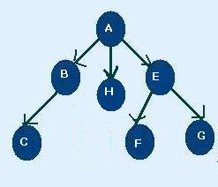
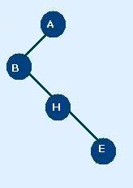
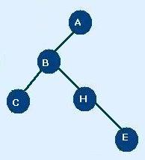
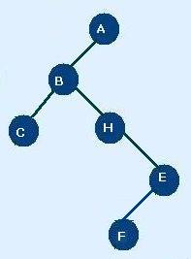
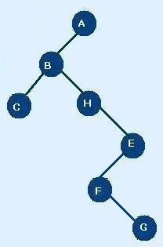
General tree to binary tree conversion
1
2
3
4
5

Slide 24
Binary tree as ADT
AbstractDataType Btree
Instances: Binary tree is a rooted tree having at the most two child nodes
Operations:
Create: This operation is for creation of Binary tree
Display: This operation is used to display each node in tree
Insert : Using this operations the node can be inserted by attaching it as left or right child
Delete : Node having left child or both can be deleted

Slide 25
Binary tree representation using array
Number the nodes sequentially level by level left to right
Even empty nodes are numbered
The number appearing against the node will work as indices of the node in array
0 | 1 | 2 | 3 | 4 | 5 | 6 | 7 | 8 | 9 | 10 | 11 | 12 | 13
13 | A | B | C | \0 | G | D | \0 | \0 | \0 | \0 | \0 | E | F
1
Index of the left child of a node i = 2 * i
Index of the right child of a node i = 2 * i +1
Index of parent node of i = i / 2
A
2
3
B
C
5
G
D
6
E
F
12
13

Slide 26
Limitations of array representation
Memory is allocated even for empty nodes
Array representation is less efficient for a sparse tree
The size of the array is fixed during compile time, hence maximum depth of the tree has to be fixed
Insertion and deletion of any node will be costlier as other nodes have to be adjusted at appropriate positions

Slide 27
Linked Representation of Binary tree
Node of binary tree consist of three fields
Data
Left child node
Right child node
Left | Data | Right
class Node
{
int data;
Node left, right;
public Node(int data)
{
key = item;
left = right = null;
}
}

Slide 28
Linked Representation of Binary tree
root
a
b
c
d
e
g
f
Left Child
element
h
rightChild

Slide 29
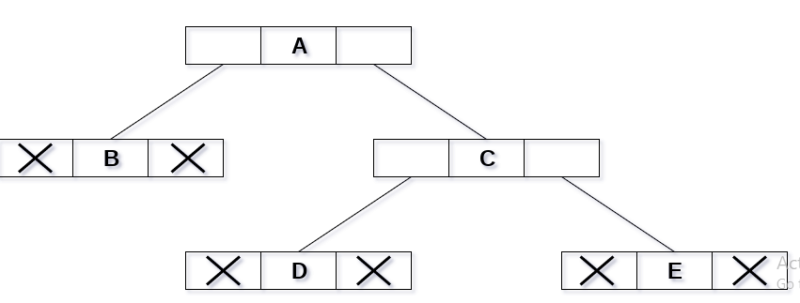
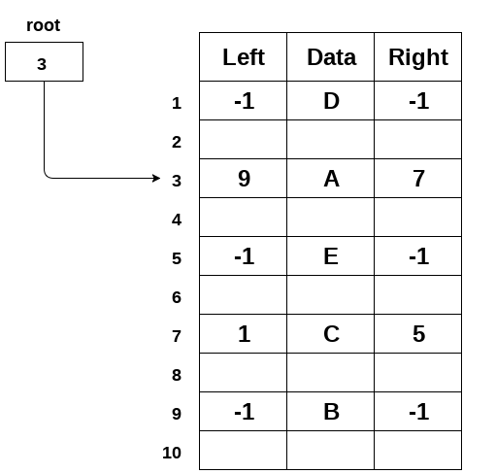

ARRAY vs Linked Representation
Tree
Sequential Representation
Linked Representation

Slide 30
Binary tree creation in JAVA
class BinaryTree
{
Node root;
BinaryTree(char data)
{
root = new Node(data);
}
BinaryTree()
{
root = null;
}
public static void main(String[] args)
{
BinaryTree tree = new BinaryTree();
tree.root = new Node('A');
tree.root.left = new Node('B');
tree.root.right = new Node('C');
tree.root.left.left = new Node('D');
}
}

Slide 31
Implementation Of
Binary Tree
In Java (onlinegdb)

Slide 32
Pre order traversal
void preorder ( node T) {
if (T!=NULL)
{
Print T.data
Preorder(T.left)
Preorder (T.right)
}
}
A
B
C
D
G
H
E
F

Slide 33
Pre order traversal
Preorder on => A + preorder on + preorder on
A + (B+ Pre on D) + (C + Pre on G + Pre on H)
A + ( B+ (D+ Pre on E) + Pre on F)0 + CGH)
A + (BDEF) + (CGH)
ABDEFCGH
B
C
A
B
G
H
C
D
D
G
H
E
F
E
F
D
E
F

Slide 34
POST order traversal
void postorder ( node T) {
if (T!=NULL)
{
postorder(T.left)
postorder (T.right)
Print T.data
}
}
A
B
C
D
G
H
E
F

Slide 35
INorder traversal
void inorder ( node T) {
if (T!=NULL)
{
inorder(T.left)
Print T.data
inorder (T.right)
}
}
A
B
C
D
G
H
E
F

Slide 36
Non recursive pre order traversal
1. While ( T!= NULL) { visit(T) S.push(T) T= T.left }
2. If the stack S is empty then traversal is finished
Else T = S. pop() T= T. right
while (T!= NULL) {
visit (T) S.push(T) T=T.left
} 3. Goto step 2

Slide 37
Non recursive in order traversal
1. While ( T!= NULL) { S.push(T) T= T.left }
2. If the stack S is empty then traversal is finished
Else T = S. pop()
visit (T) T= T.right
while (T!= NULL) { S.push(T) T=T.left
} 3. Goto step 2
In non recursive preorder traversal , a node is visited before it is pushed into stack.
In non recursive inorder, a node is visited immediately after it is popped from the stack

Slide 38
Non recursive POST order traversal in C++
1. While ( T!= NULL) { S.push(T, 0) T= T.left }
2. If the stack S is empty then traversal is finished
Else T, flag = S. pop()
if flag ==1 then visit (T) else
S.push(T,1)
T= T.right
while (T!=NULL) { S.push(T,0) T=T.left } 3. Goto step 2
In post order traversal, an element is visited after the right sub tree is traversed
Thus, the address of the node should be preserved in stack until it has been printed.
An additional field ‘flag’ in stack is used

Slide 39
Simulation of Non recursive POST order traversal
A
Step 1: Start traversing from root, traverse and continue traversing left
Every node encountered is pushed onto stack with flag=0
B
E
C
F
D
B | 0
A | 0

Slide 40
Simulation of Non recursive POST order traversal
A
Step 2: pop and element from stack. Node B will be popped. Since, flag=0, push it back with flag=1
Now, we traverse the right sub tree of B
B
E
C
F
D
B | 1
A | 0

Slide 41
Simulation of Non recursive POST order traversal
A
Step 3: Start traversing from the root of the subtree rooted at C (right subtree of B). Continue traversing left
Every node encountered is pushed onto stack with flag = 0
B
E
C
F
D
D | 0
C | 0
B | 1
A | 0

Slide 42
Simulation of Non recursive POST order traversal
A
Step 4: Pop an element from stack. Node D will be popped. Since flag =0, push it again with flag=1
Now traverse right subtree of D. Right subtree of D is NULL
B
E
C
F
D
D | 1
C | 0
B | 1
A | 0

Slide 43
Simulation of Non recursive POST order traversal
A
Step 5: Pop an element from stack. Node D will be popped. Since flag =1, visit D
B
E
C
F
D
C | 0
B | 1
A | 0

Slide 44
Simulation of Non recursive POST order traversal
A
Step 6: Pop, Since flag od C=0 , change it to 1 and push is again .Goto right of node C
B
E
C
F
D
C | 1
B | 1
A | 0

Slide 45
Simulation of Non recursive POST order traversal
A
Step 7: Since right of C=NULL, Visit C
B
E
C
F
D
B | 1
A | 0

Slide 46
Simulation of Non recursive POST order traversal
A
Step 8: Since flag of B=1, visit B
B
E
C
F
D
A | 0

Slide 47
Simulation of Non recursive POST order traversal
A
Step 9: Goto right of node A
B
E
C
F
D
F | 0
E | 0
A | 1

Slide 48
Simulation of Non recursive POST order traversal
A
Step 10: Goto right of node F
B
E
C
F
D
F | 1
E | 0
A | 1

Slide 49
Simulation of Non recursive POST order traversal
A
Step 11: Visit node F
B
E
C
F
D
E | 0
A | 1

Slide 50
Simulation of Non recursive POST order traversal
A
Step 12: Goto right of node E
B
E
C
F
D
E | 1
A | 1

Slide 51
Simulation of Non recursive POST order traversal
A
Step 13: Visit node E
B
E
C
F
D
A | 1

Slide 52
Simulation of Non recursive POST order traversal
A
Step 14: Visit node A
B
E
C
F
D

Slide 53
function to create copy of tree (recursive)
node * copy(node *T)
{
node *P P = NULL if(T!=NULL) { P = new node P.data = T.data P.left = copy(T.left)
P.right = copy(T.right) }
return (P)
}

Slide 54
Function for counting leaf node (recursive)
int count_leaf( node *T)
{
int n;
if(T==NULL) return 0;
if(T.left == NULL && T.right == NULL)
return 1;
n = count_leaf(T.left) + count_leaf(T.right);
return (n);
}

Slide 55
Binary search tree
When we store ordered data in an array we have Binary search algorithm for efficient searching
But insertion and deletion in array requires lot of shuffling
The problem with linked lists however is their search algorithm is sequential
Hence we really need a data structure that has an efficient search algorithm and at the same time efficient insert and delete algorithms

Slide 56
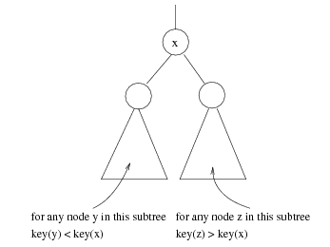
Binary search tree
A binary search tree is a binary tree with following properties:
For every node X
All the keys in its left subtree are smaller than the key value in X
All the keys in its right subtree are larger than the key value in X

Slide 57
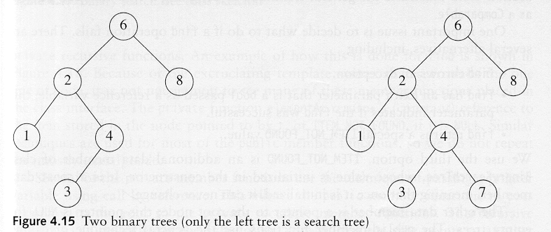
Binary search tree
A binary search tree
Not a binary search tree

Slide 58
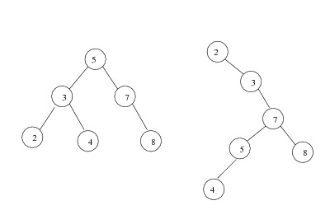
Binary search tree
The same set of keys may have different BSTs

Slide 59
Is this BST?
17
6
19

Slide 60
Is this BST?
17
6
19
3
14

Slide 61
Is this BST?
17
19
22

Slide 62
Is this BST?
17
22
19

Slide 63
Is this BST?
17
6
11

Slide 64
Is this BST?
17
6
19
11
15

Slide 65
Is this BST?
17
6
19
3
22

Slide 66
Is this BST?
17
17
6
6
19
4
4
15
2
Add node -

Slide 67
Is this BST?
17
6
19
4
15
2

Slide 68
Is this BST?
17
17
6
19
19
4
15
22
Add node -

Slide 69
Is this BST?
17
6
19
4
15
22

Slide 70
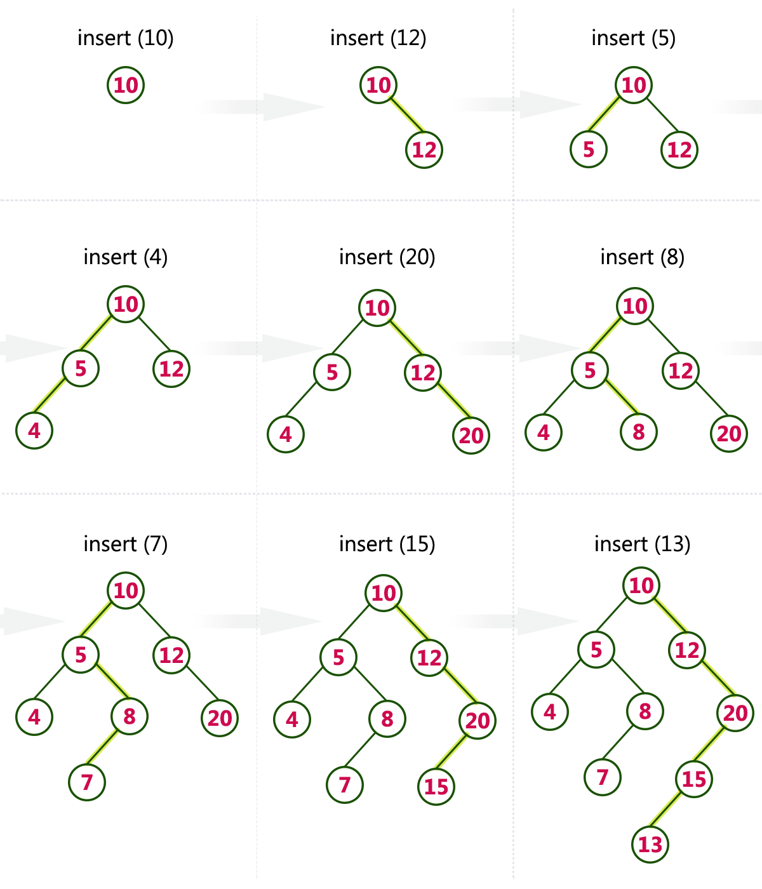
Construct a Binary Search Tree by inserting the following sequence of numbers...
10,12,5,4,20,8,7,15 and 13

Slide 71
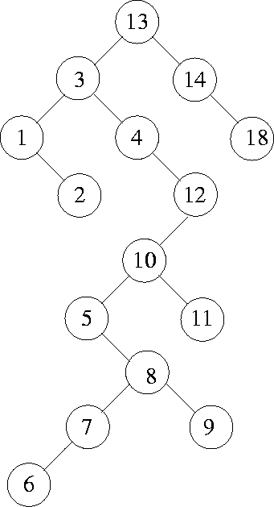
Construct a Binary Search Tree by inserting the following sequence of numbers...
13, 3, 4, 12, 14, 10, 5, 1, 8, 2, 7, 9, 11, 6, 18

Slide 72
Insertion in bst
addBST (root, newnode)
If (empty)
Set root to newnode
Return newnode
End if
If (newnode < root)
Return addBST (left sub tree, newnode)
Else
Return addBST (right sub tree, newnode)
End if
End addBST

Slide 73
Deletion from bst
If the node doesn’t have children's then just delete the reference for this node from its parent and recycle the memory
If the node has only right sub tree then
Simply attach right subtree to delete's nodes parent
If the node has only left sub tree then
Simply attach left subtree to delete's nodes parent

Slide 74
Deletion from bst
If the node has left and right subtree then
Find largest node from left subtree and replace that with node we have to delete
OR
Find smallest node from right subtree and replace that with node we have to delete

Slide 75
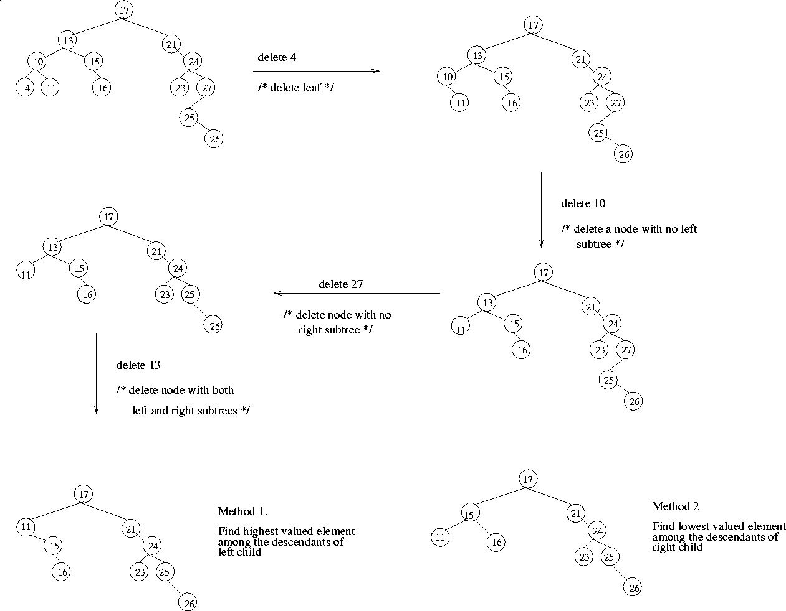

Slide 76
Implementation Of
Binary Search Tree
In Java (onlinegdb)

Slide 77
Google Classroom Link: https://classroom.google.com/c/NDYyMzU5NTIyMzU3?cjc=fwulhav Google Classroom Code: fwulhav
Thank You

